Slide 1
Unix/Linux Command Line
File system exploration

Slide 2
How is data stored at the laptop?

Slide 3
File System
Emily
Data
Thesis
Notes.txt
Tools
One.txt
Two.txt
Format
Stats
Old

Slide 4
File System Functions
Ű Store data
Ű Control data
Ű Retrieve data

Slide 5
File System
Ű Store data into the named files
Ű Hierarchy of files
Ű Structure and logic rules used to manage files

Slide 6
How to explore the file system?

Slide 7
File Manager
Ű GNOME’s Nautilus file manager
Ű Windows Explorer
Ű Finder

Slide 8
BASH
Ű command interpreter
Ű programming language
Ű command processor that typically runs in a text window, where the user types commands that cause
Ű actions
Ű can also read and execute commands from a file, called a script

Slide 9
File System Exploration Commands
Ű ls
Ű cd
Ű pwd
Ű du
Ű df

Slide 10
ls
Ű Lists the contents of a directory
ls [OPTION]... [FILE]...

Slide 11
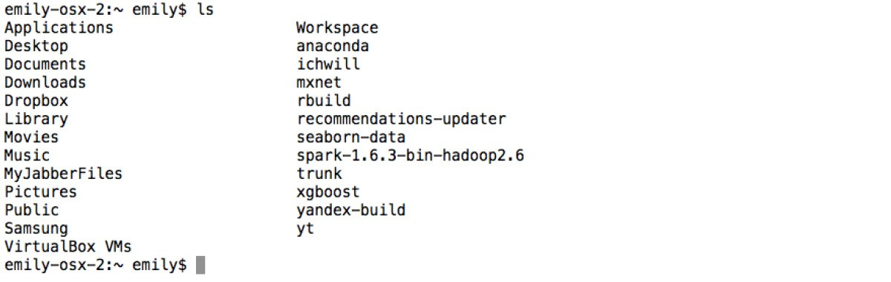
ls
yandex — bash

Slide 12
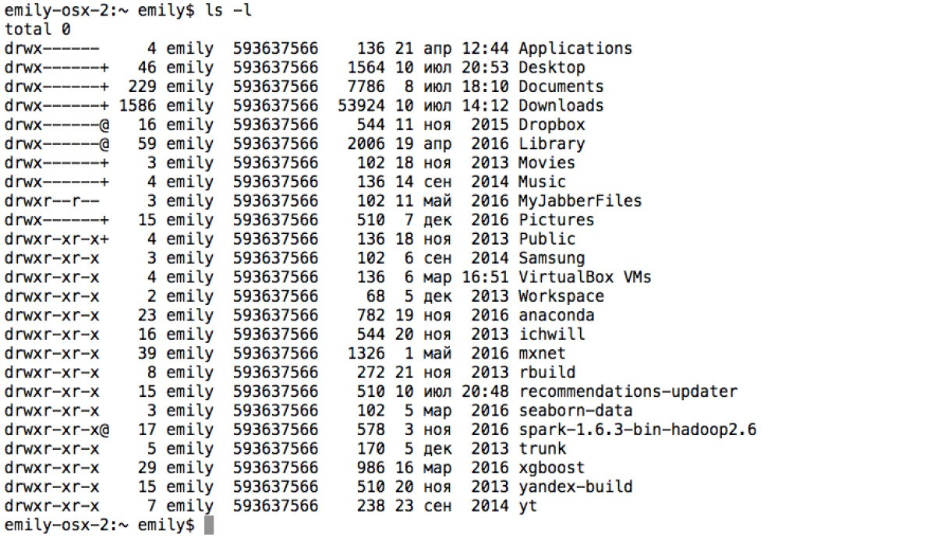
ls -l
yandex — bash

Slide 13
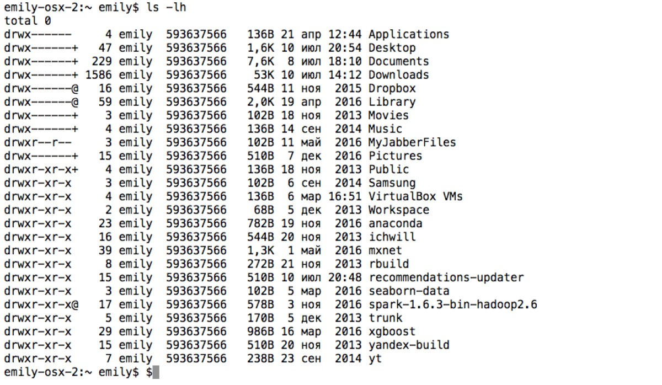
ls -lh
yandex — bash

Slide 14
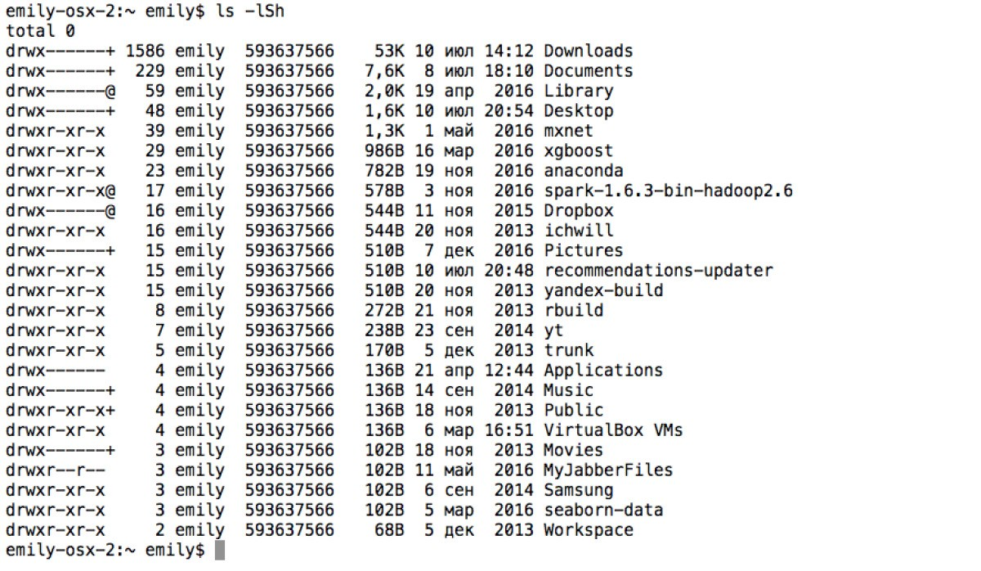
ls -lSh
yandex — bash

Slide 15
cd
Ű change directory
cd [-L|-P] directory

Slide 16
cd
yandex — bash

Slide 17
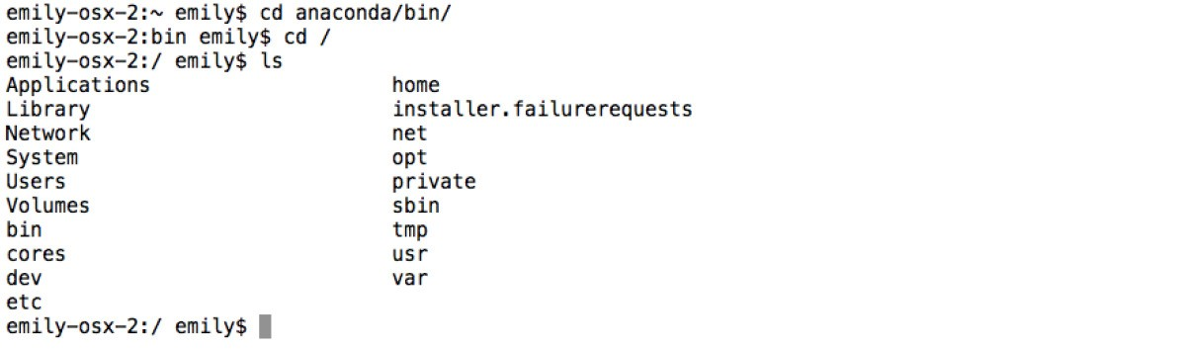
cd /
yandex — bash

Slide 18
cd ..
yandex — bash

Slide 19
cd ~
yandex — bash

Slide 20
pwd
Ű Prints the whole pathname of the current directory
pwd [OPTION]...

Slide 21
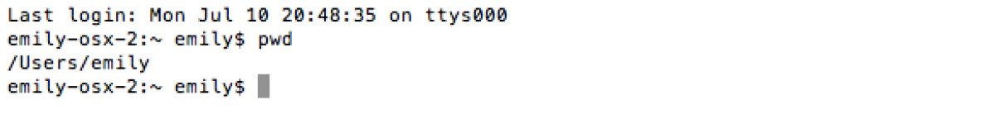
pwd
yandex — bash

Slide 22
du
Ű estimates and displays the disk space used by files
du [OPTION]... [FILE]...

Slide 23
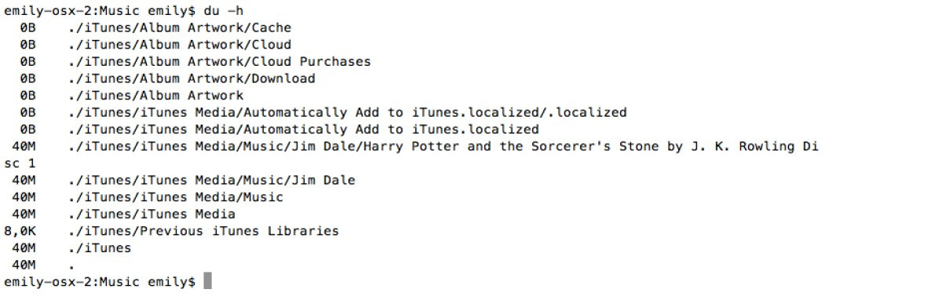
du
yandex — bash

Slide 24
df
Ű reports the amount of available disk space being used
by file systems
df [OPTION]... [FILE]...

Slide 25
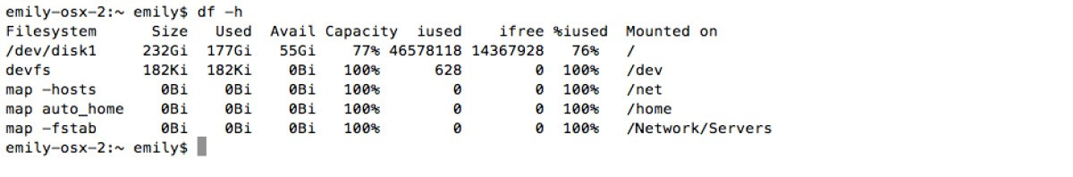
df
yandex — bash

Slide 26
question
Ű How to print list of files in the current directory?
Ű What command should we use to change directory?
Ű How to print path to the current directory?

Slide 27
How to get help with bash?

Slide 28
man is the interface used to view the system's reference manuals.
man
Ű man pwd
Ű To exit manual type “q”

Slide 29
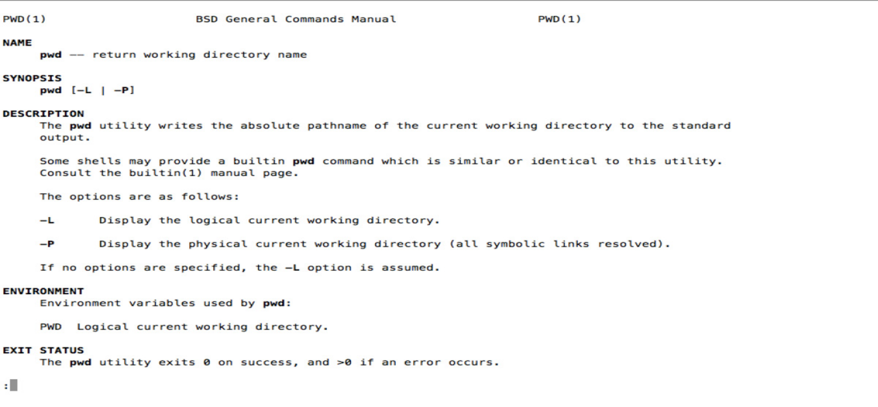
man pwd
yandex — bash

Slide 30
Outcome
Ű File system
Ű Bash
Ű To explore FS we use:
Ű LS
Ű CD
Ű PWD
Ű DU
Ű DF
Ű To get help we use:
Ű MAN

Slide 31
How can we modify files and directories?

Slide 32
File system exploration commands
Ű mkdir
Ű cp Ű mv Ű rm
Ű touch

Slide 33
mkdir
Ű "make directory", creates directories on a file system
mkdir [OPTION ...] DIRECTORY ...

Slide 34
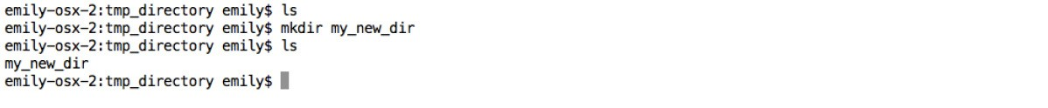
mkdir
yandex — bash

Slide 35
cp
Ű makes copies of files and directories
cp [OPTION]... SOURCE... DIRECTORY

Slide 36
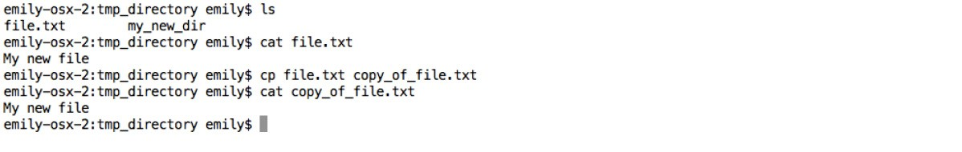
cp
yandex — bash

Slide 37
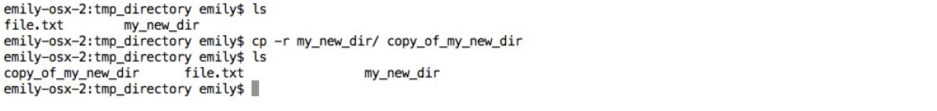
cp -r
yandex — bash

Slide 38
mv
Ű moves or renames files
mv [OPTION]... SOURCE... DIRECTORY

Slide 39
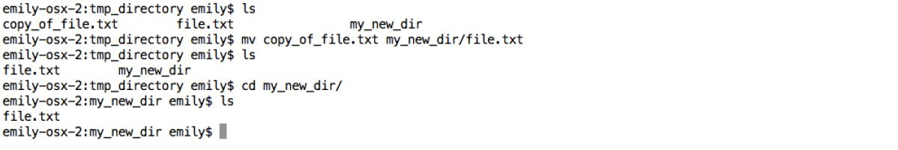
mv
yandex — bash

Slide 40
rm
Ű removes (deletes) files or directories
rm [OPTION]... FILE...

Slide 41
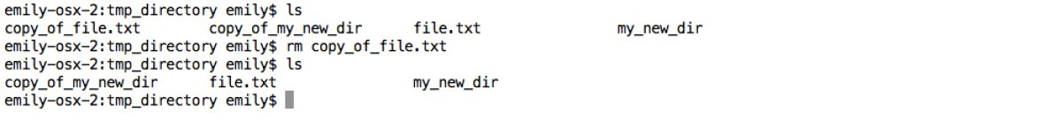
rm
yandex — bash

Slide 42
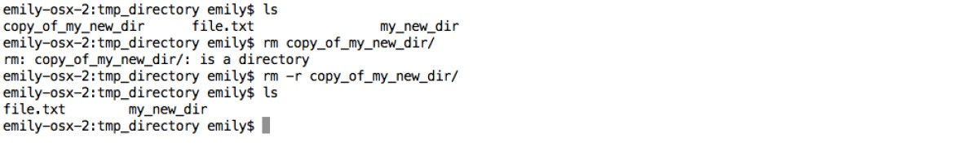
rm -r
yandex — bash

Slide 43
touch
Ű changes file timestamp
touch [OPTION]... FILE...

Slide 44
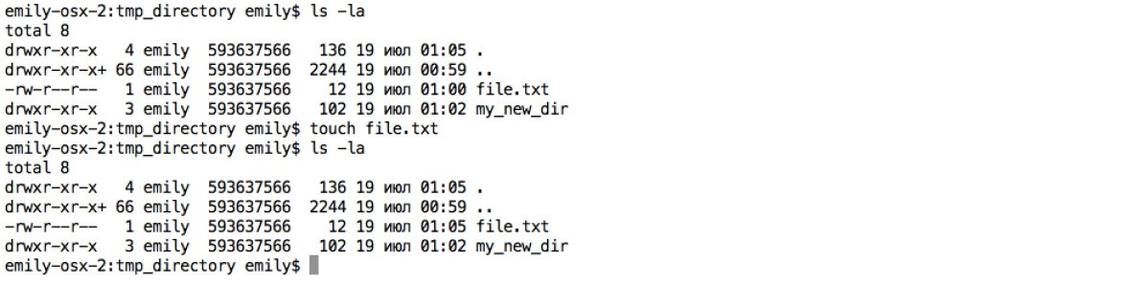
touch
yandex — bash

Slide 45
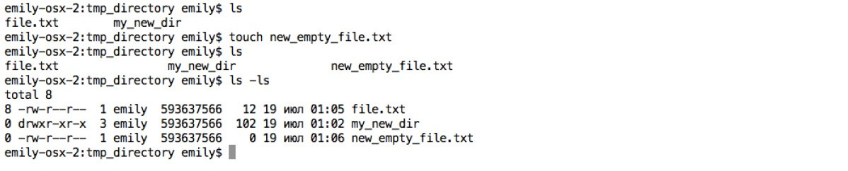
touch
yandex — bash

Slide 46
quiz
Ű How to create empty file ‘tmp.txt’?
Ű How to rename file ‘tmp.txt’ to
‘temporary_logs.txt’?
Ű How to delete all ‘.txt’ files in the current directory?

Slide 47
Outcome
Ű For modifying files and directories we use the following bash commands:
Ű mkdir — make directory
Ű cp — copy file or directory
Ű mv — move or rename file or directory
Ű rm — delete file or directory
Ű touch — update file timestamps or create empty file

Slide 48
Unix Command Line
File content exploration Part I

Slide 49
How can we explore files?

Slide 50
Files exploration commands
Ű cat
Ű head
Ű tail
Ű more Ű less Ű wc
Ű grep

Slide 51
cat
Ű displays the contents of a file at the command line
Ű copies or append text files into a document
cat [OPTION]... [FILE]...

Slide 52
cat
yandex — bash

Slide 53
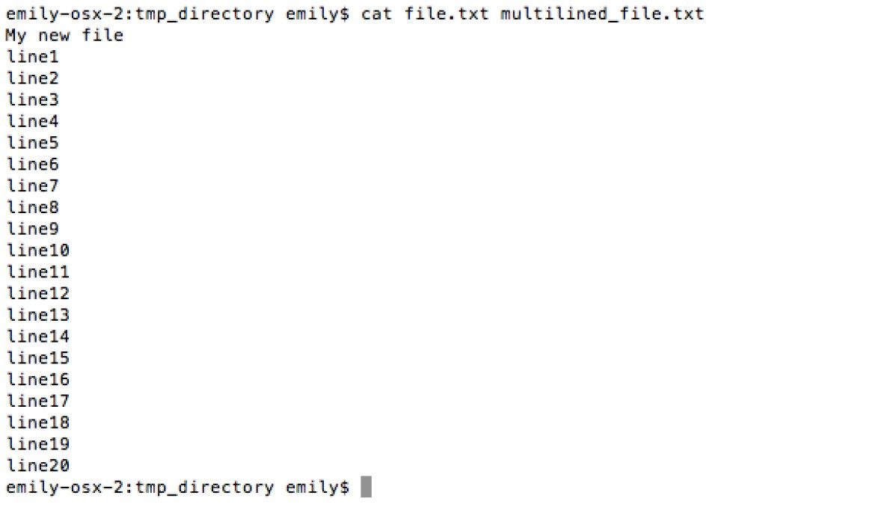
cat
yandex — bash

Slide 54
head
Ű prints the first part of files
head [OPTION]... [FILE]...

Slide 55
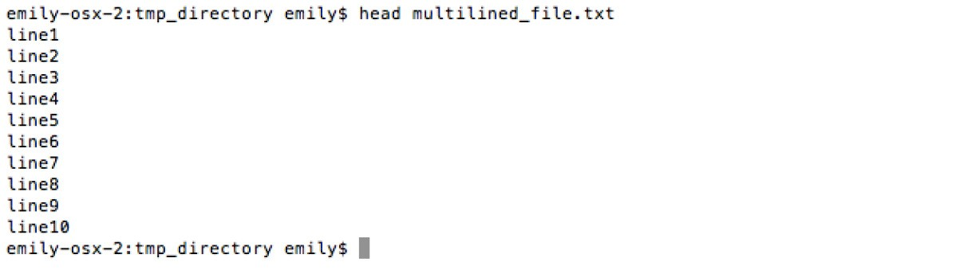
head
yandex — bash

Slide 56
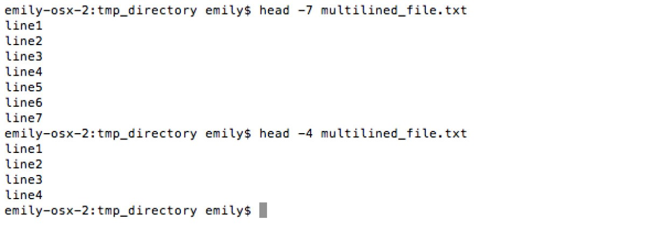
head -n
yandex — bash

Slide 57
tail
Ű prints the last part of files
tail [OPTION]... [FILE]...

Slide 58
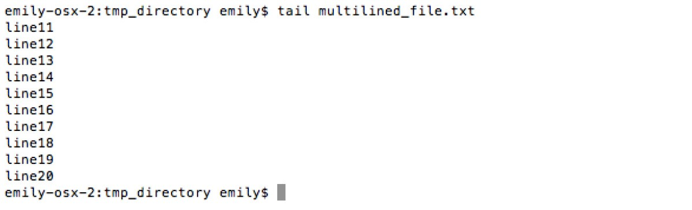
tail
yandex — bash

Slide 59
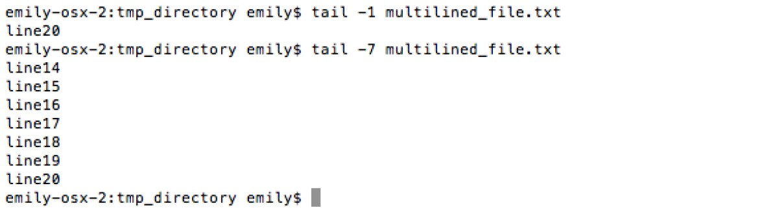
tail -n
yandex — bash

Slide 60
more
Ű displays text, one screen at a time

Slide 61
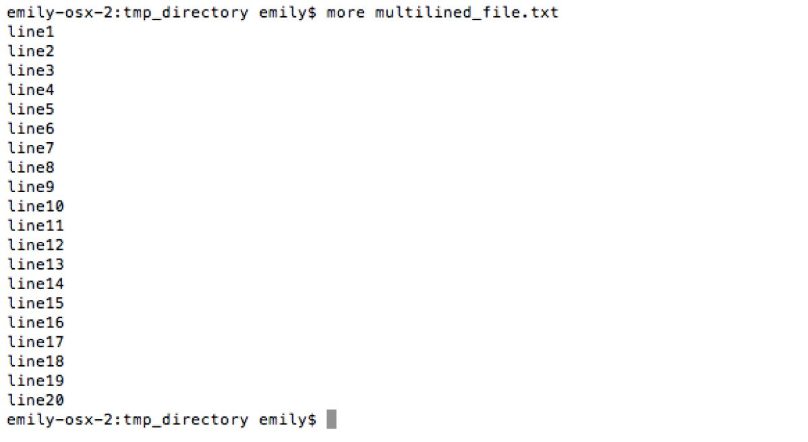
more
yandex — bash

Slide 62
less
Ű displays text, allows scrolling

Slide 63
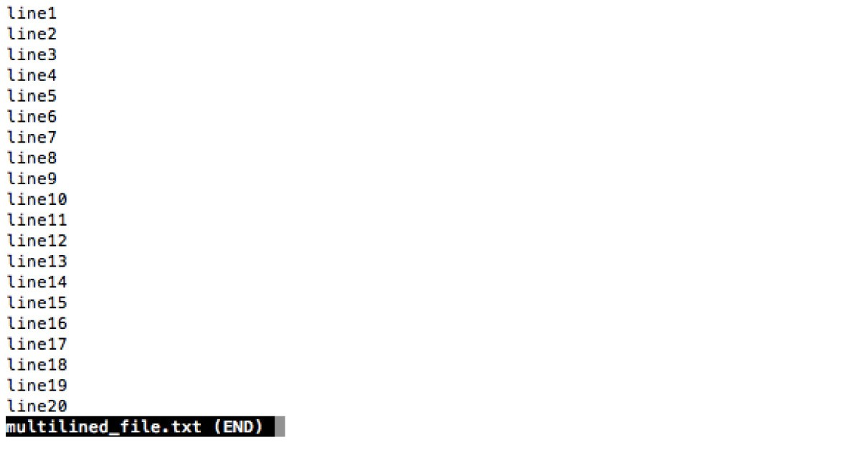
less
yandex — bash

Slide 64
wc
Ű "word count" prints a count of lines, words, and bytes for each file
wc [OPTION]... [FILE]...

Slide 65
wc
yandex — bash

Slide 66
wc -c
yandex — bash

Slide 67
wc -l
yandex — bash

Slide 68
grep
Ű "global regular expression print" processes text and prints any lines which match a specified pattern
grep [OPTIONS] PATTERN [FILE...]

Slide 69
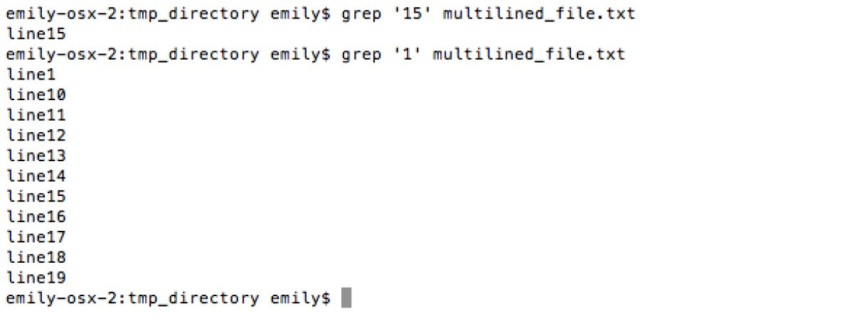
grep
yandex — bash

Slide 70
quiz
Ű How can we print first 17 lines of “temporary_logs.txt”?
Ű How can we calculate number of lines for file “temporary_logs.txt”?
Ű How can we print all lines from file “temporary_logs.txt”, that contains ‘data’ substring?

Slide 71
Outcome
Ű For exploring files content we use the following commands:
Ű cat — print file content
Ű head/tail — print firt/last part of files
Ű more/less — output file content by screens
Ű wc — “word count”
Ű grep — find any lines which match a specified pattern

Slide 72
Unix Command Line
File content exploration Part II

Slide 73
How can we modify text files?

Slide 74
Files editing commands and tools
Ű vim Ű cut Ű tr
Ű sort
Ű awk
Ű special symbolic: |, ||, &, &&, >, >>

Slide 75
vim
Ű an advanced text editor
Ű improved version of vi redactor
Ű efficient text (including programming code) editing
vim [options] [filelist]

Slide 76
Ű to start vim: ”vim filename”
vim
Ű to edit file: “:i” (insert)
Ű to save file and quit vim: “:wq”
Ű to quit vim without file saving: “:!q”

Slide 77
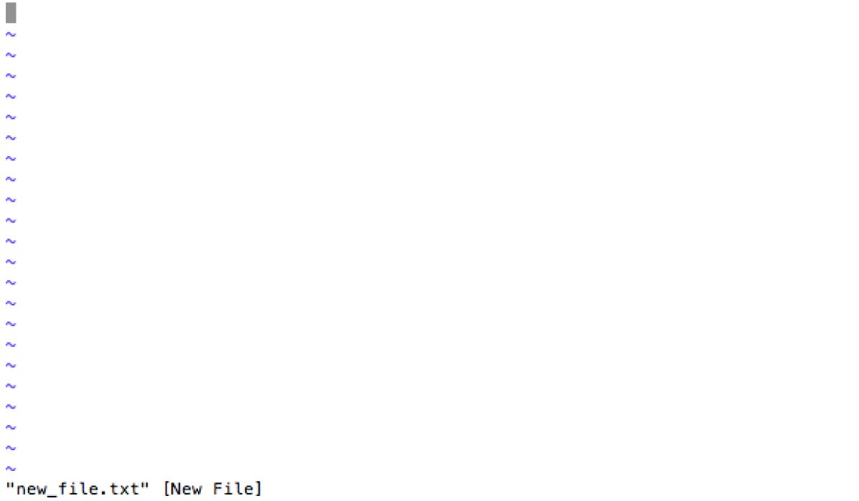
vim
yandex — bash

Slide 78
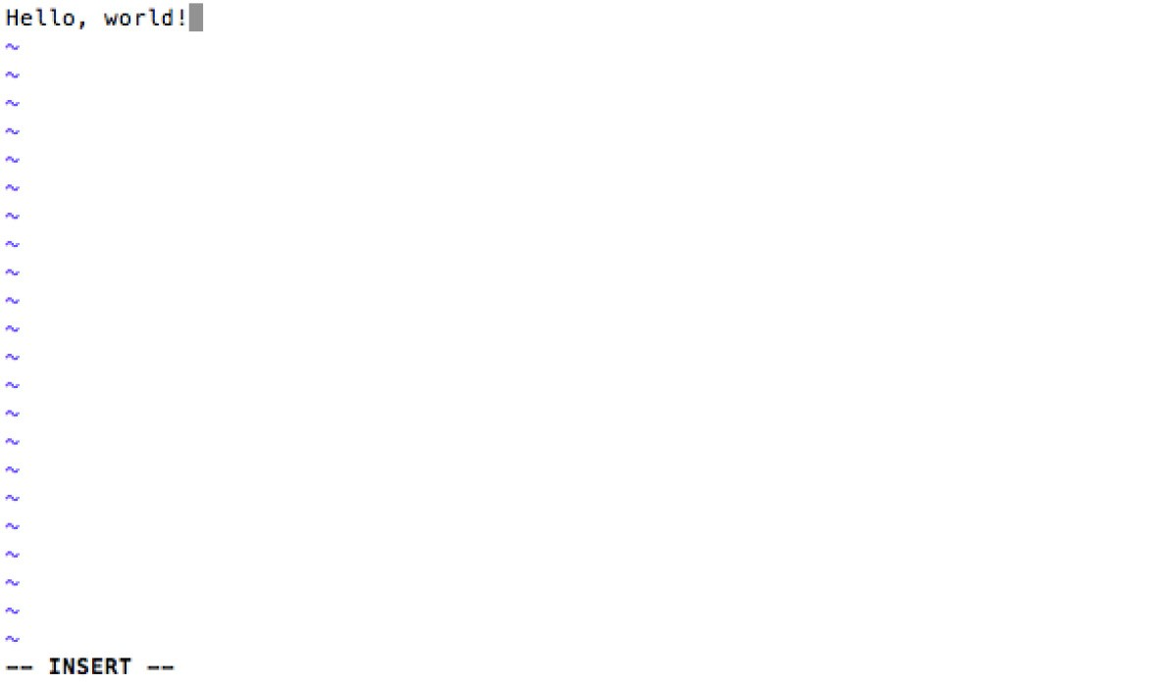
vim
yandex — bash

Slide 79

vim
yandex — bash

Slide 80
vim
yandex — bash

Slide 81
Ű .vimrc file with vim configuration
vim
Ű example:
Ű colorscheme darkblue
Ű set tabstop=4
Ű set shiftwidth=4
Ű set smarttab
Ű set expandtab

Slide 82
cut
Ű drops sections of each line of a file/files
cut OPTION... [FILE]...

Slide 83
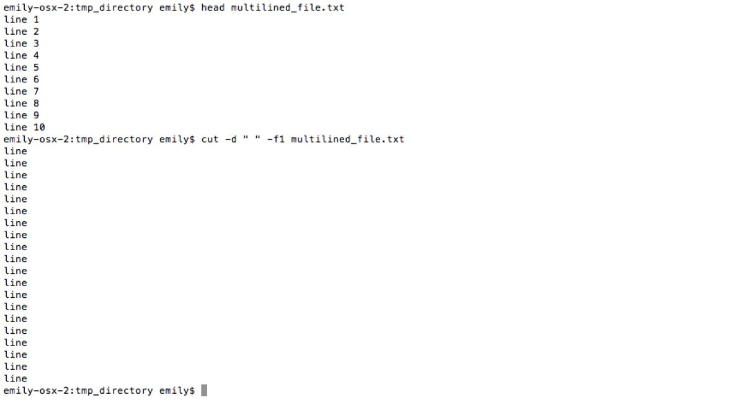
cut -d -f
yandex — bash

Slide 84
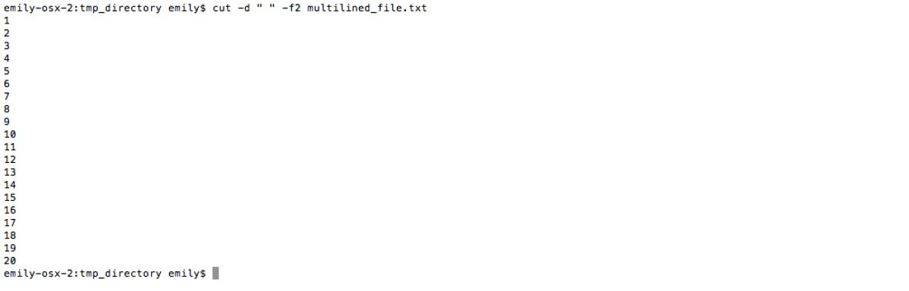
cut -d -f
yandex — bash

Slide 85
tr
Ű translates one set of characters to another
tr [-Ccsu] string1 string2

Slide 86
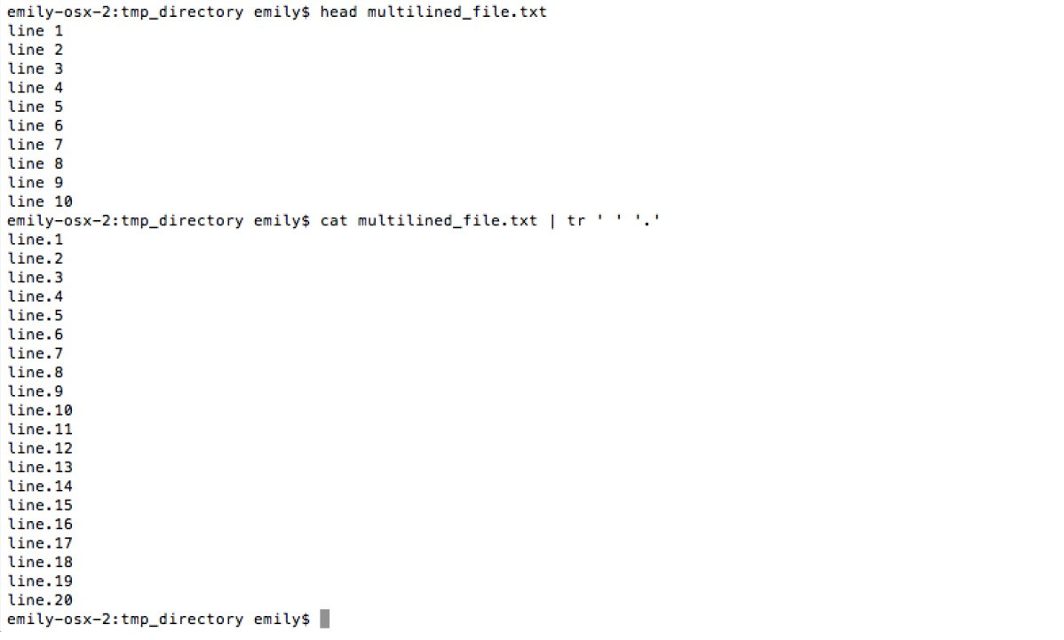
tr
yandex — bash

Slide 87
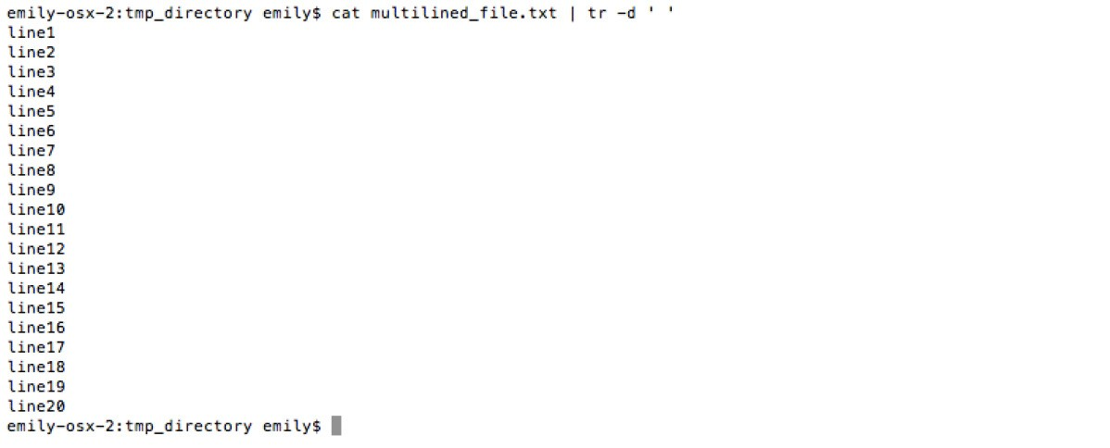
tr -d
yandex — bash

Slide 88
sort
Ű sorts the contents of a text file
sort [OPTION]... [FILE]...

Slide 89
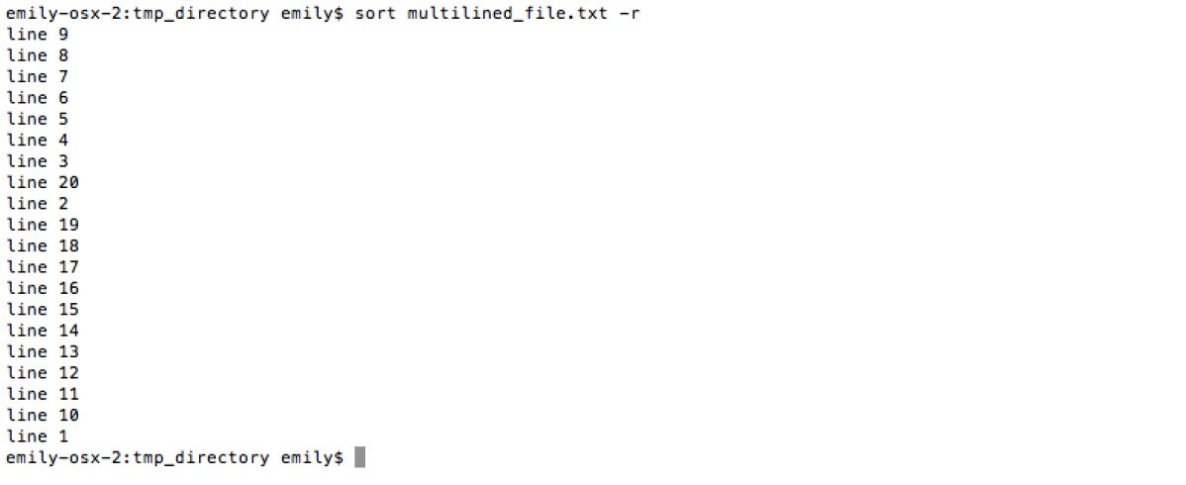
sort -r
yandex — bash

Slide 90
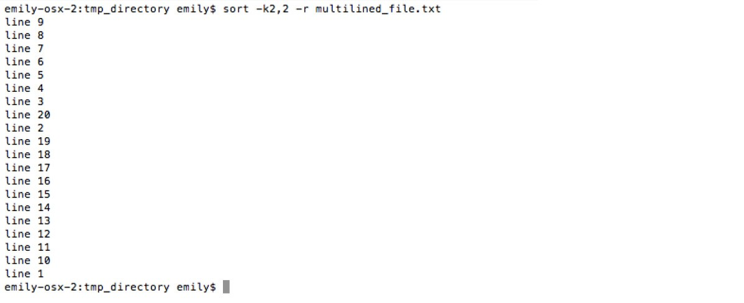
sort -r -k
yandex — bash

Slide 91
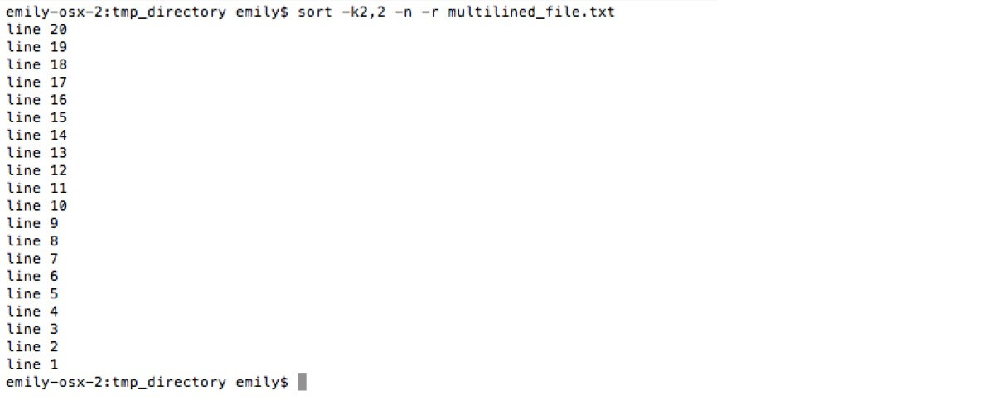
sort -r -k -n
yandex — bash

Slide 92
awk
Ű "Aho, Weinberger, and Kernighan”, Bell Labs, 1970s
Ű interpreted programming language text processing
awk [ -F fs ] [ -v var=value ] [ 'prog' | -f progfile ] [ file ... ]

Slide 93
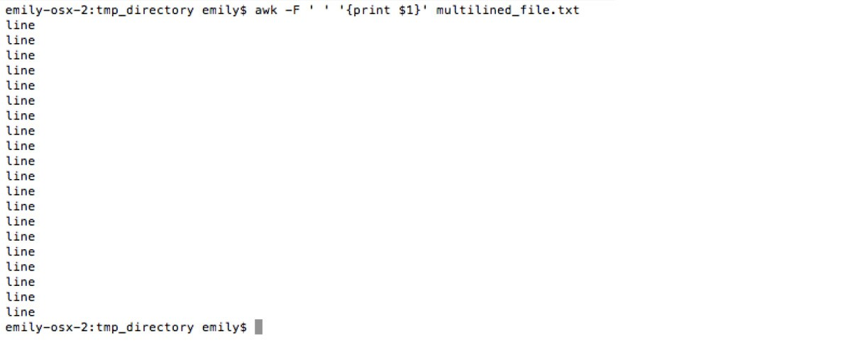
awk
yandex — bash

Slide 94
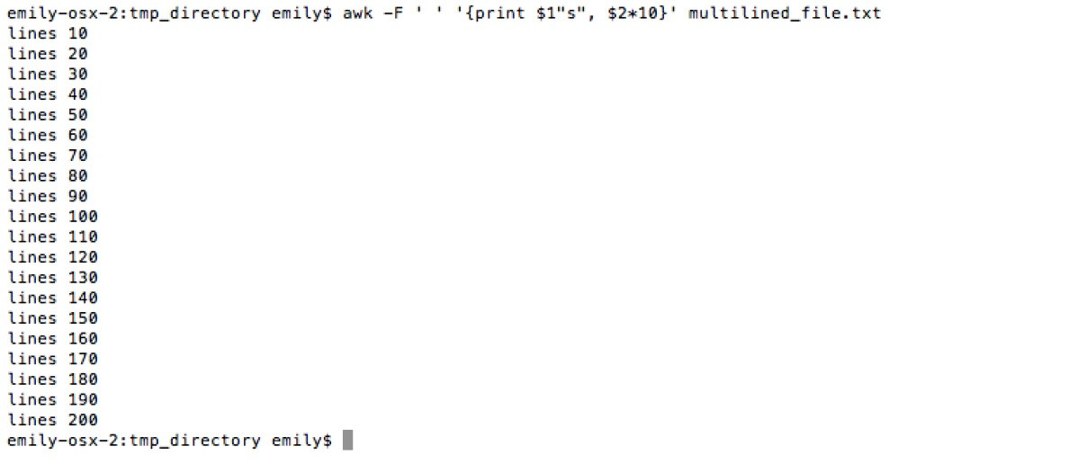
awk
yandex — bash

Slide 95
operators
Ű > overwrites the file if it exists or creates it if it doesn't exist
Ű >> appends to a file or creates the file if it doesn't exist

Slide 96
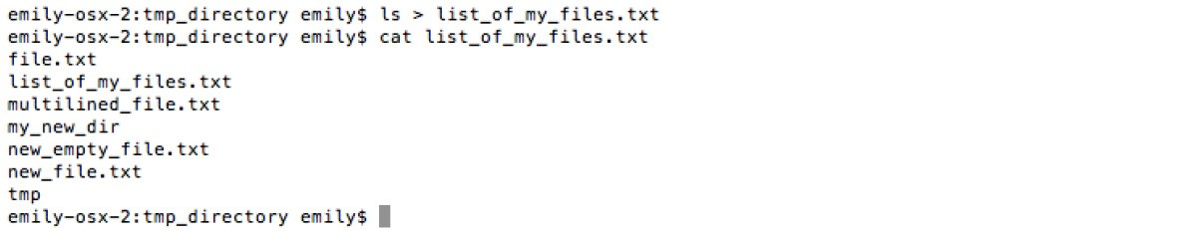
> operator
yandex — bash

Slide 97
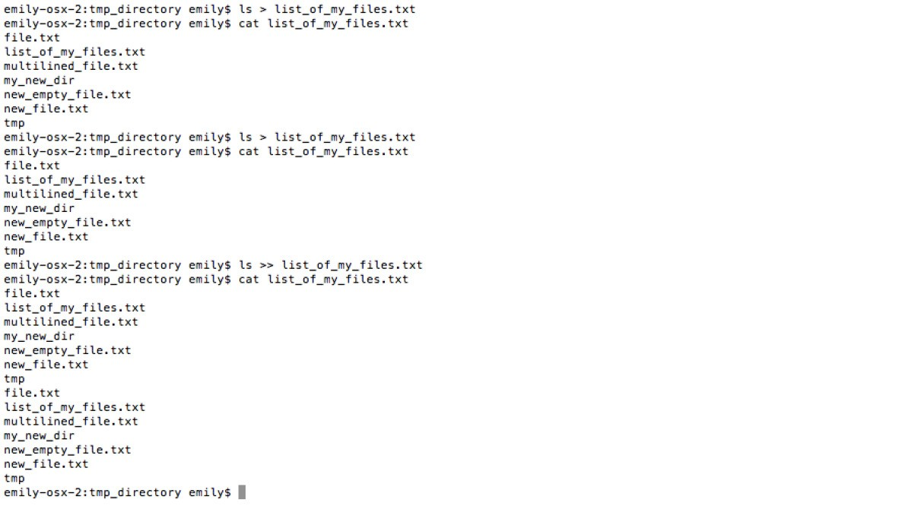
>> operator
yandex — bash

Slide 98
operators
Ű | pipe operator, output of first command acts as an input to the second command

Slide 99
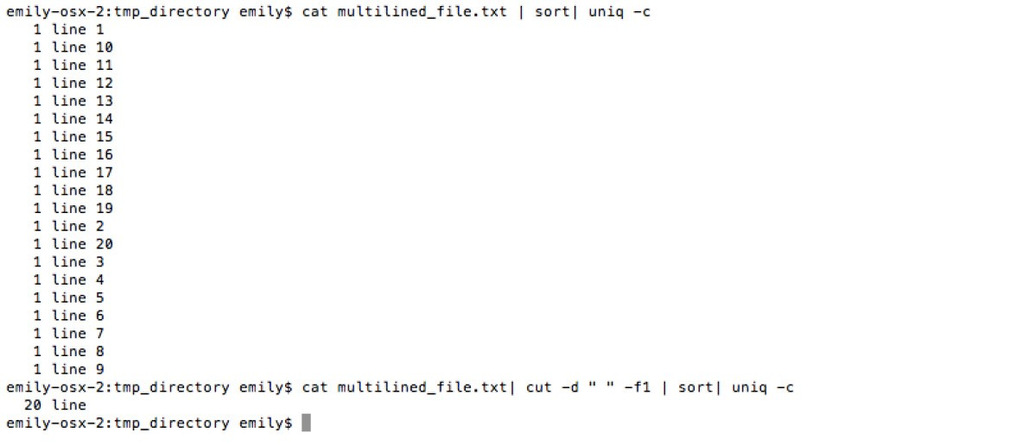
pipe
yandex — bash

Slide 100
More operators!
Ű & make the command run in background
Ű || execute the second command only, if the execution of first command succeeds
Ű && execute second command only if the execution of first command fails

Slide 101
quiz
Ű How to quit vim redactor without saving the edited file?
Ű How to substitute all commas ‘,’ to spaces ‘ ’ in a file?
Ű How to take first 5 columns of file and write into another file?

Slide 102
Outcome
Ű We use the following list of commands for file editing and exploring:
Ű vim — text editor
Ű cut — drop sections of files line by line Ű tr — translate one substring to another Ű sort — sort file by lines
Ű awk — programming language for text editing
Ű special symbolic: |, ||, &, &&, >, >>

Slide 103
Unix Command Line
Processes

Slide 104
What happens on a server?

Slide 105
Commands for processes managing
Ű free Ű top Ű ps
Ű kill

Slide 106
free
Ű displays the total amount of free and used memory
free [options]

Slide 107
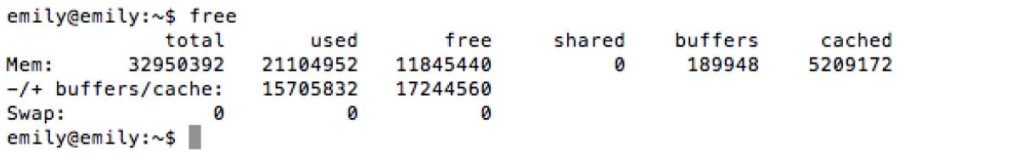
free
yandex — bash

Slide 108
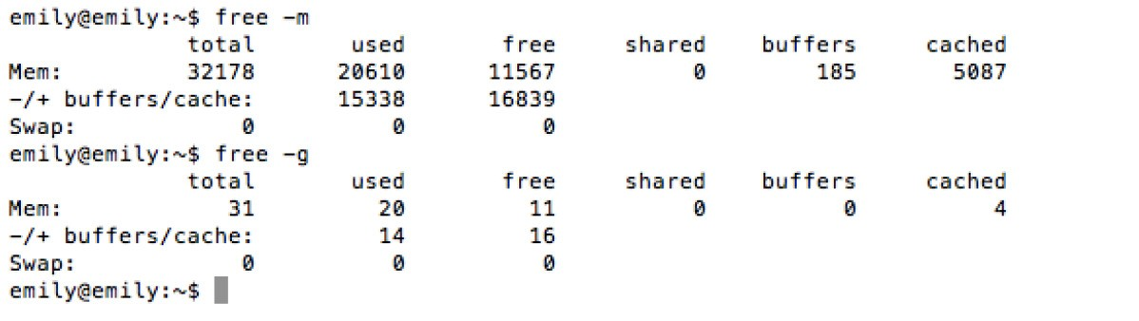
free -g
yandex — bash

Slide 109
top
Ű provides a dynamic real-time view of a running system
top [options]

Slide 110
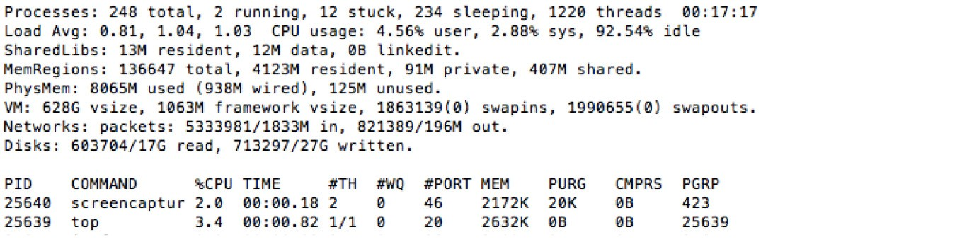
top
yandex — bash

Slide 111
ps
Ű provides snapshot of the status of currently running processes
ps [options]

Slide 112
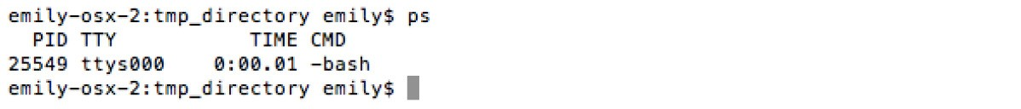
ps
yandex — bash

Slide 113
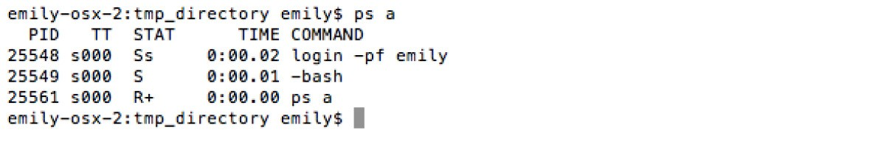
ps a
yandex — bash

Slide 114
kill
Ű sends a signal to a process
kill [-s] [-l] %pid

Slide 115
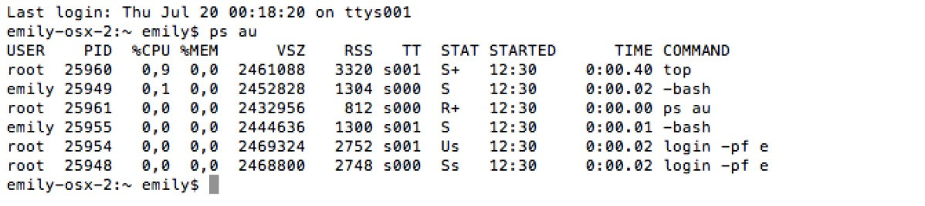
kill
yandex — bash

Slide 116
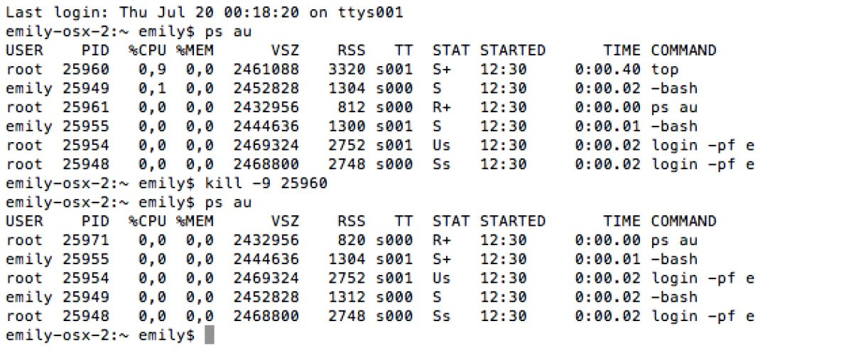
kill
yandex — bash

Slide 117
Nice =)
Ű runs a command with a modified scheduling priority
nice [OPTION] [COMMAND [ARG]...]

Slide 118
quiz
Ű How to display a real-time view of a running system?
Ű How to display the total amount of free and used memory?
Ű What does nice command do?

Slide 119
Outcome
Ű We use the following list of commands for processes managing:
Ű free Ű top Ű ps
Ű kill
Ű And one nice command: nice =)

